Slide 1
Group 4
NetWORKING

Slide 2
What is a Computer Network?
A computer network is a group of computers linked to each other that enables the computer to communicate with another computer and share their resources, data, and applications.

Slide 3
What Do Networks Do?
Computer networks are used to carry out a large number of tasks through the sharing of information.
Some of the things that networks are used for include:
Communicating using email, video, instant messaging and other methods
Sharing devices such as printers, scanners and photocopiers
Sharing files
Sharing software and operating programs on remote systems
Allowing network users to easily access and maintain information

Slide 4
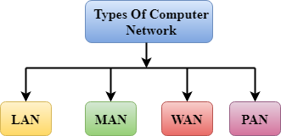
Types of Computer Network

Slide 5
LAN(Local Area Network)
Local Area Network is a group of computers connected to each other in a small area such as building, office.
LAN is used for connecting two or more personal computers through a communication medium such as twisted pair, coaxial cable, etc.
It is less costly as it is built with inexpensive hardware such as hubs, network adapters, and ethernet cables.
The data is transferred at an extremely faster rate in Local Area Network.
Local Area Network provides higher security.

Slide 6
PAN(Personal Area Network)
Personal Area Network is a network arranged within an individual person, typically within a range of 10 meters.
Personal Area Network is used for connecting the computer devices of personal use is known as Personal Area Network.
Thomas Zimmerman was the first research scientist to bring the idea of the Personal Area Network.
Personal Area Network covers an area of 30 feet.
Personal computer devices that are used to develop the personal area network are the laptop, mobile phones, media player and play stations.

Slide 7
MAN(Metropolitan Area Network)
A metropolitan area network is a network that covers a larger geographic area by interconnecting a different LAN to form a larger network.
Government agencies use MAN to connect to the citizens and private industries.
In MAN, various LANs are connected to each other through a telephone exchange line.
The most widely used protocols in MAN are RS-232, Frame Relay, ATM, ISDN, OC-3, ADSL, etc.
It has a higher range than Local Area Network(LAN)

Slide 8
WAN(Wide Area Network)
A Wide Area Network is a network that extends over a large geographical area such as states or countries.
A Wide Area Network is quite bigger network than the LAN.
A Wide Area Network is not limited to a single location, but it spans over a large geographical area through a telephone line, fibre optic cable or satellite links.
The internet is one of the biggest WAN in the world.
A Wide Area Network is widely used in the field of Business, government, and education.

Slide 9
Components
Nodes: A network node is any device participating in a network.
Host : A host is a node that participates is user applications, either as a server, client, or both.
Server :A server is a type of host that offers resources to the other hosts. Typically a server accepts connections from clients who request a service function.
Hub : Hub is a central device that splits the network connection into multiple devices. When computer requests for information from a computer, it sends the request to the Hub. Hub distributes this request to all the interconnected computers.

Slide 10
What is Switch ?
A switch is a high-speed device that receives incoming data packets and redirects them to their destination on a local area network (LAN).
Essentially, switches are the traffic cops of a simple local area network.
A switch creates an electronic tunnel between source and destination ports for a split second that no other traffic can enter. This results in communication without collisions.
switch is limited to node-to-node communication on the same network.

Slide 11
What is Hub ?
A Hub is a hardware device that divides the network connection among multiple devices. When computer requests for some information from a network, it first sends the request to the Hub through cable. Hub will broadcast this request to the entire network. All the devices will check whether the request belongs to them or not. If not, the request will be dropped.

Slide 12
What is Router ?
A router is a hardware device which is used to connect a LAN with an internet connection. It is used to receive, analyze and forward the incoming packets to another network.
A router works in a Layer 3 (Network layer) of the OSI Reference model.
A router forwards the packet based on the information available in the routing table.
It determines the best path from the available paths for the transmission of the packet.

Slide 13
Cables
Cable is a transmission media that transmits the communication signals. There are three types of cables:
Twisted pair cable: It is a high-speed cable that transmits the data over 1Gbps or more.
Coaxial cable: Coaxial cable resembles like a TV installation cable. Coaxial cable is more expensive than twisted pair cable, but it provides the high data transmission speed.
Fibre optic cable: Fibre optic cable is a high-speed cable that transmits the data using light beams. It provides high data transmission speed as compared to other cables. It is more expensive as compared to other cables, so it is installed at the government level.

Slide 14
Transmission modes
The way in which data is transmitted from one device to another device is known as transmission mode.
The transmission mode is also known as the communication mode.
Each communication channel has a direction associated with it, and transmission media provide the direction. Therefore, the transmission mode is also known as a directional mode.
The transmission mode is defined in the physical layer.

Slide 15
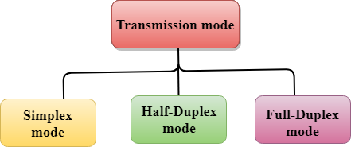
Transmission mode

Slide 16
Simplex mode
In Simplex mode, the communication is unidirectional, i.e., the data flow in one direction.
A device can only send the data but cannot receive it or it can receive the data but cannot send the data.
The radio station is a simplex channel as it transmits the signal to the listeners but never allows them to transmit back.
Keyboard and Monitor are the examples of the simplex mode as a keyboard can only accept the data from the user and monitor can only be used to display the data on the screen.
The main advantage of the simplex mode is that the full capacity of the communication channel can be utilized during transmission.

Slide 17
Half-Duplex mode
In a Half-duplex channel, direction can be reversed, i.e., the station can transmit and receive the data as well.
Messages flow in both the directions, but not at the same time.
The entire bandwidth of the communication channel is utilized in one direction at a time.
In half-duplex mode, it is possible to perform the error detection, and if any error occurs, then the receiver requests the sender to retransmit the data.
A Walkie-talkie is an example of the Half-duplex mode. In Walkie-talkie, one party speaks, and another party listens. After a pause, the other speaks and first party listens. Speaking simultaneously will create the distorted sound which cannot be understood.

Slide 18
Full-duplex mode
In Full duplex mode, the communication is bi-directional, i.e., the data flow in both the directions.
Both the stations can send and receive the message simultaneously.
Full-duplex mode has two simplex channels. One channel has traffic moving in one direction, and another channel has traffic flowing in the opposite direction.
The Full-duplex mode is the fastest mode of communication between devices.
The most common example of the full-duplex mode is a telephone network. When two people are communicating with each other by a telephone line, both can talk and listen at the same time.

Slide 19
What is Topology?
Topology defines the structure of the network of how all the components are interconnected to each other.
Network topology refers to how various nodes, devices, and connections on your network are physically or logically arranged in relation to each other.
Geometric representation of how the computers are connected to each other is known as topology.
Network Topology refers to the layout of a network and how different nodes in a network are connected to each other and how they communicate. Topologies are either physical (the physical layout of devices on a network) or logical (the way that the signals act on the network media, or the way that the data passes through the network from one device to the next).

Slide 20
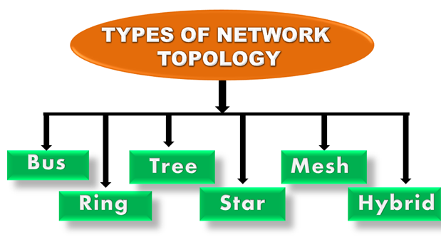
Types of Network Topology

Slide 21
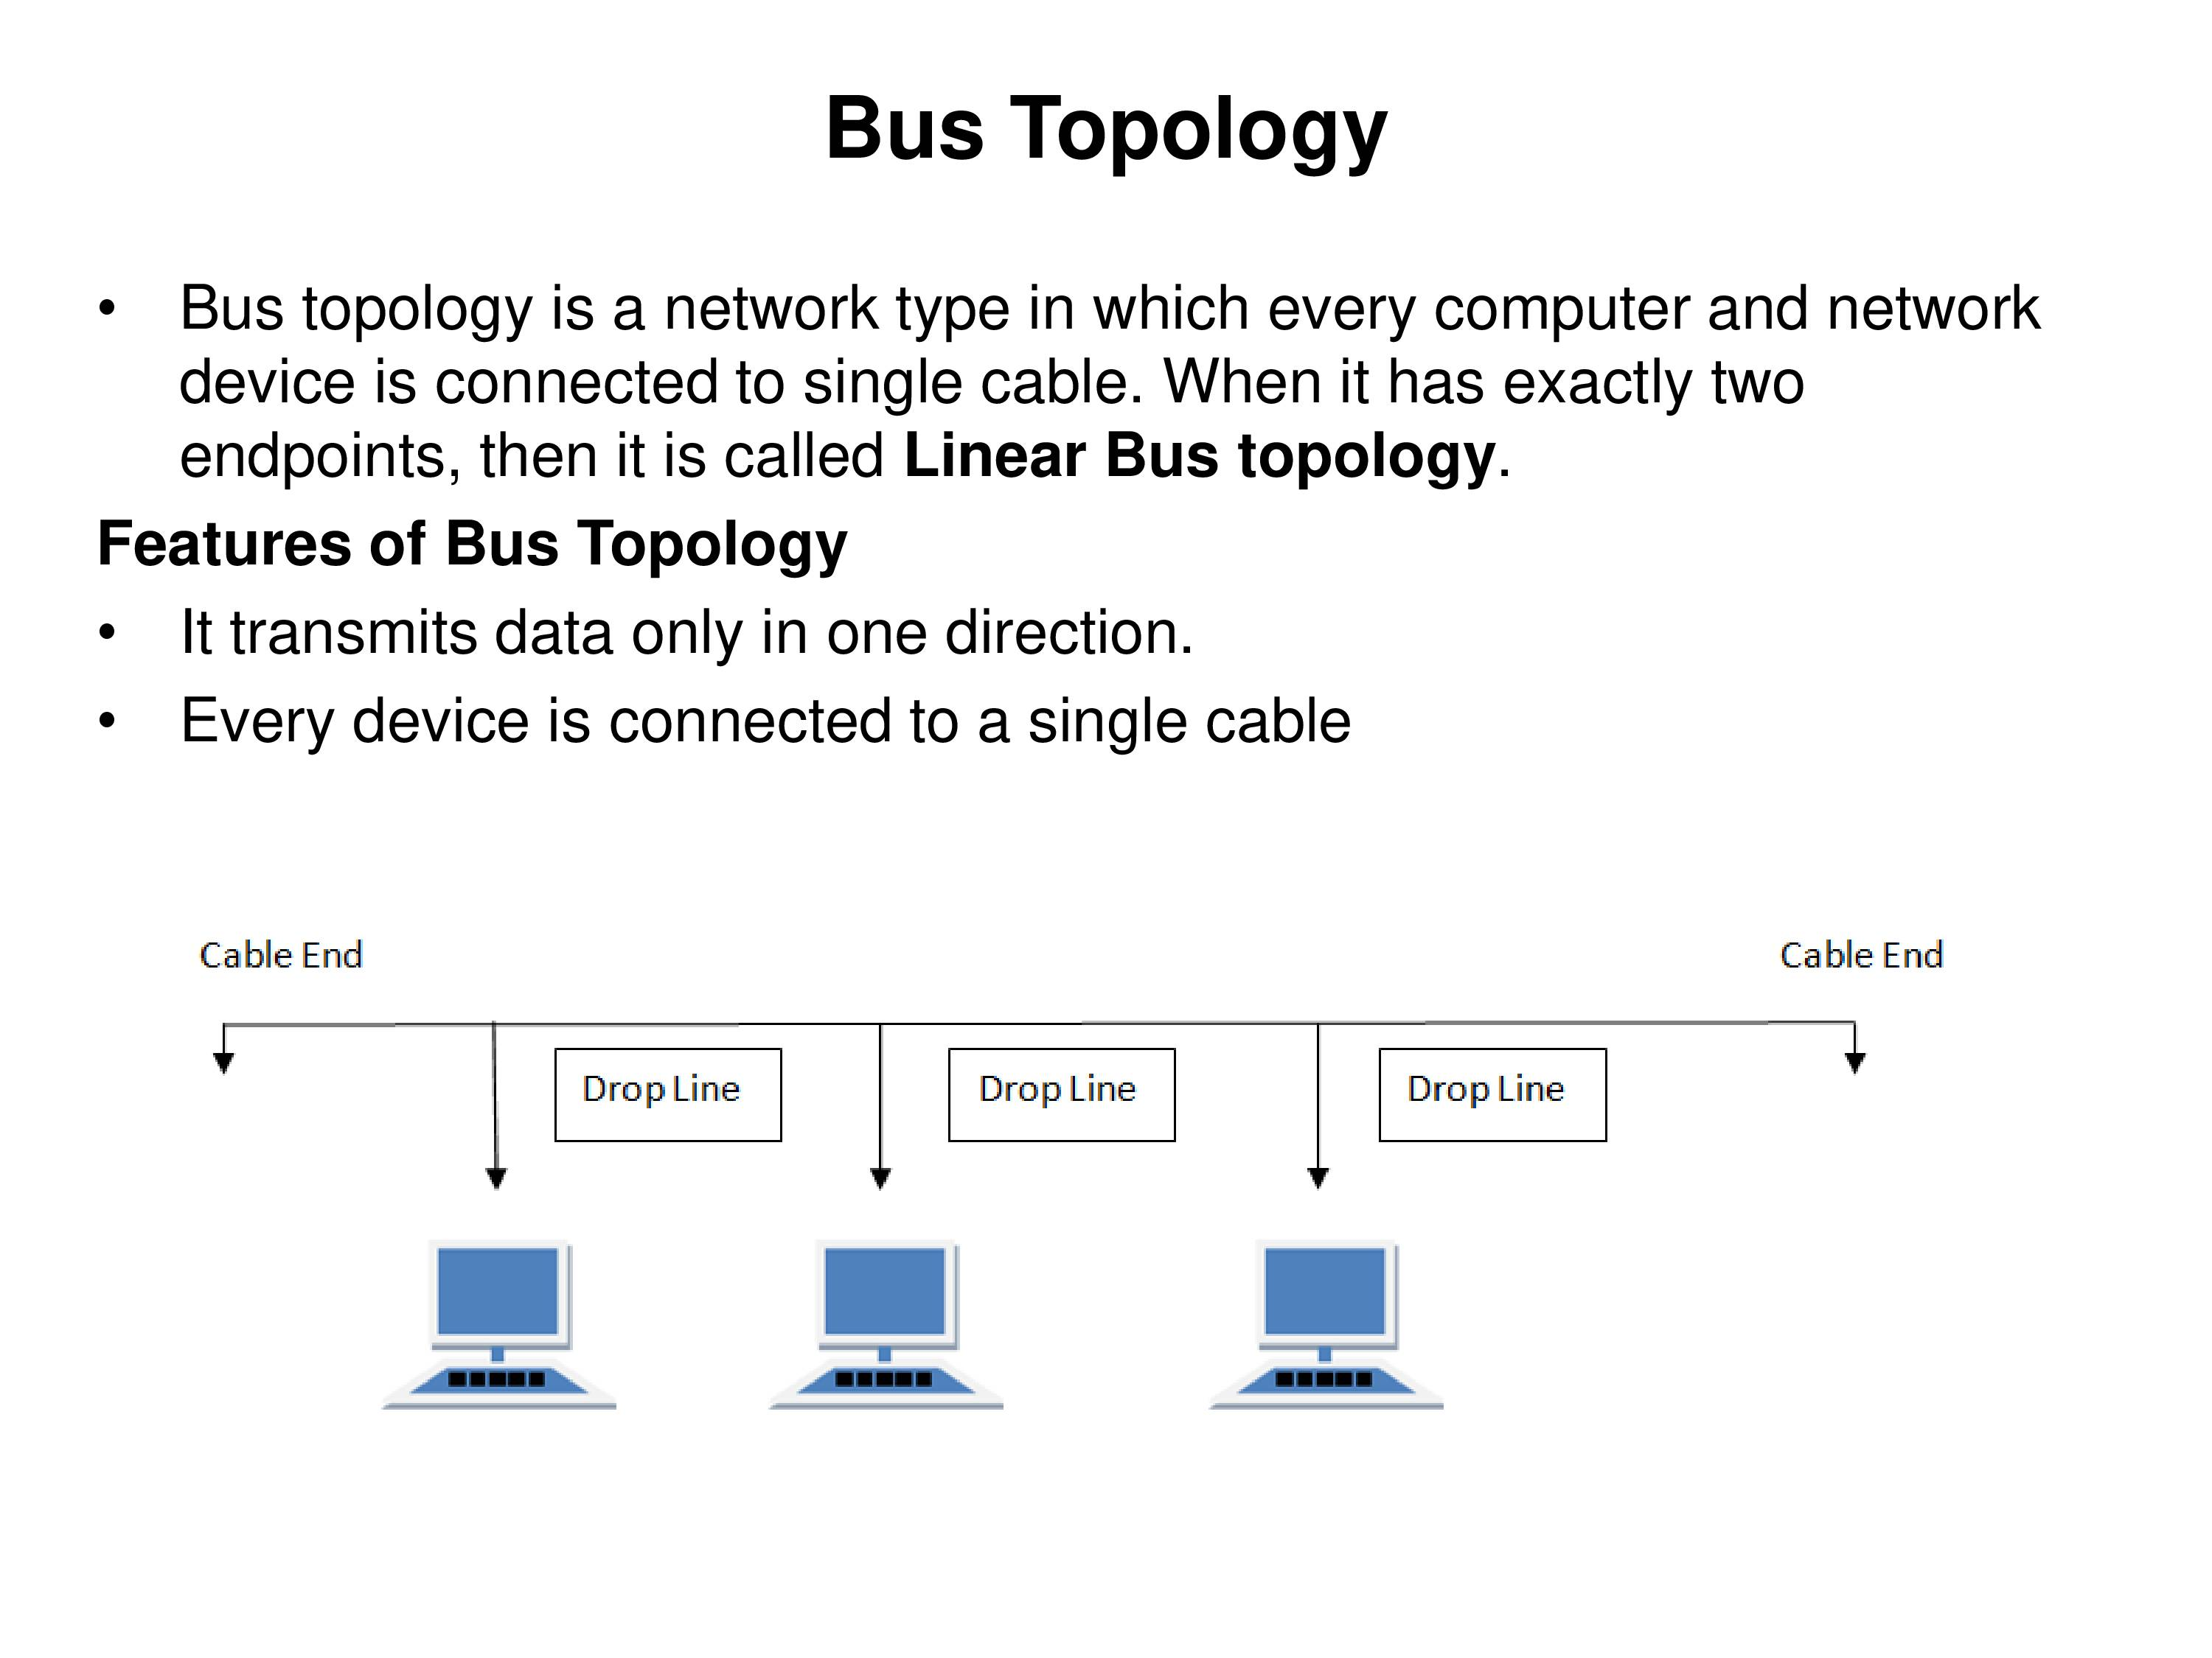
Bus Topology

Slide 22
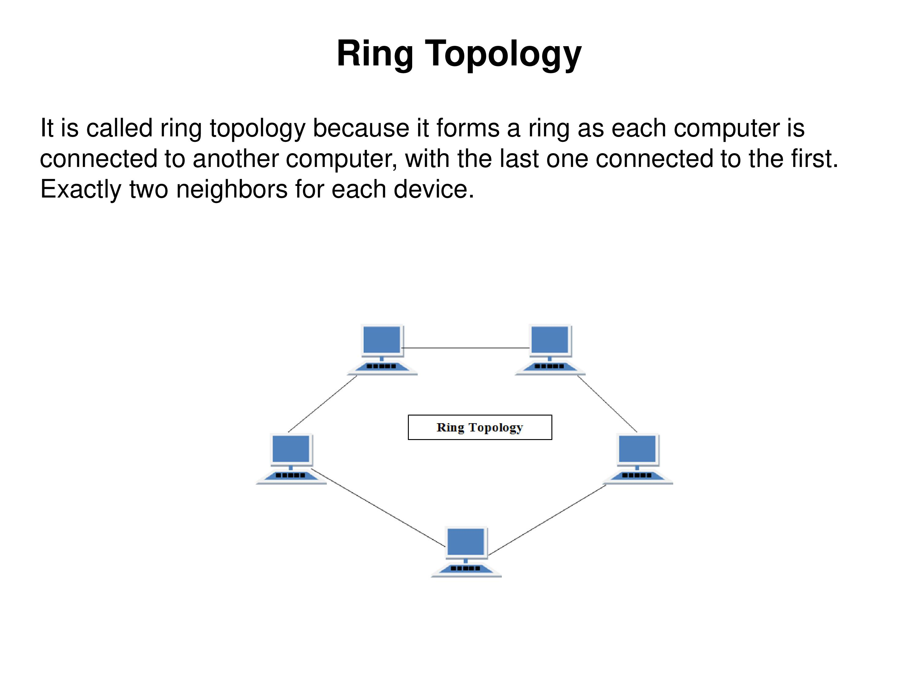
Ring Topology

Slide 23
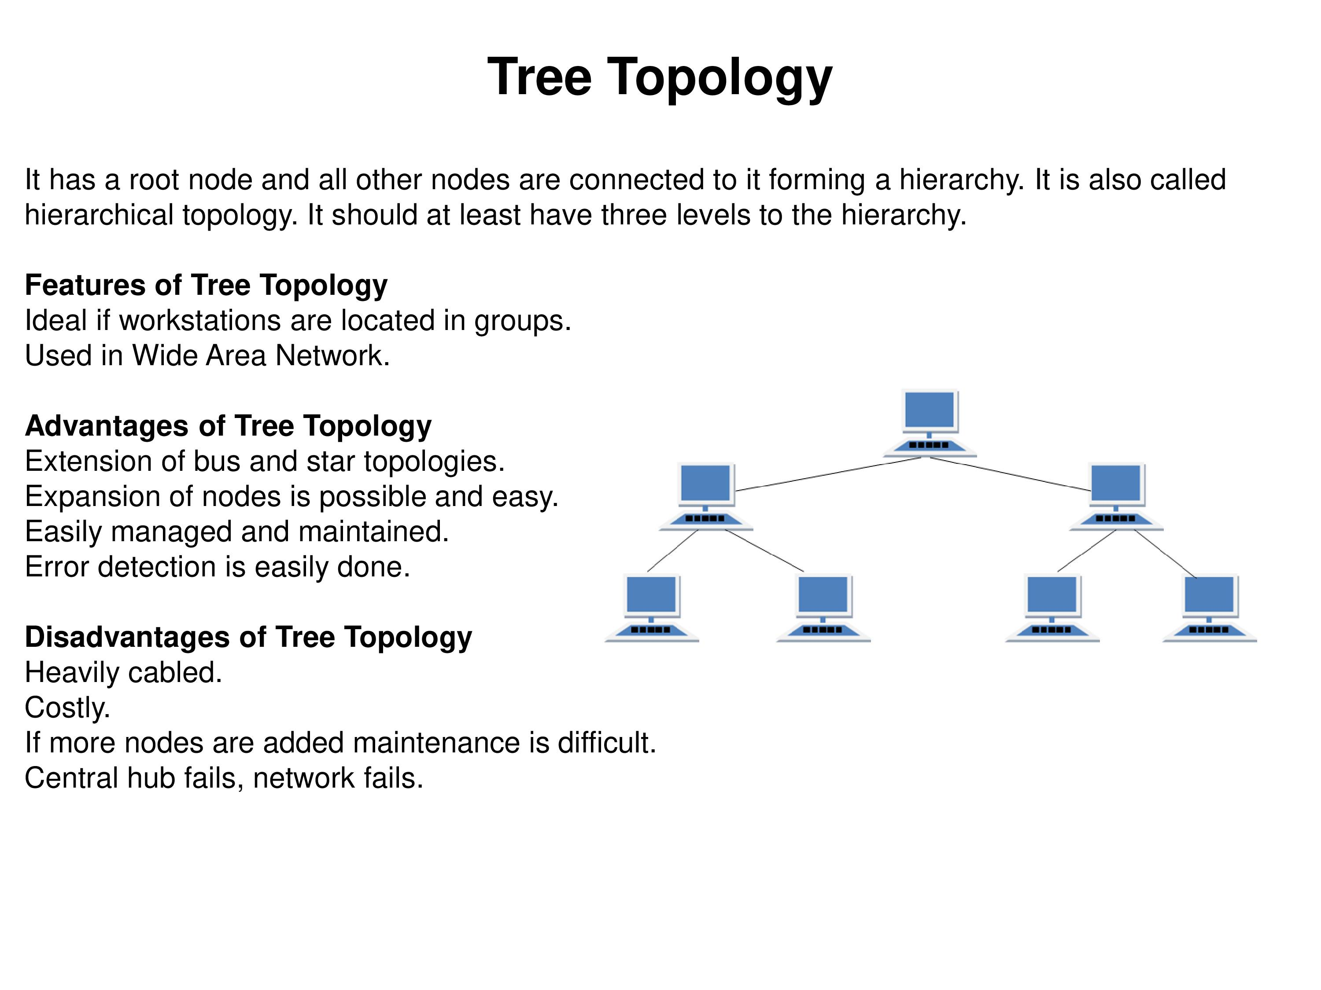
Tree topology

Slide 24
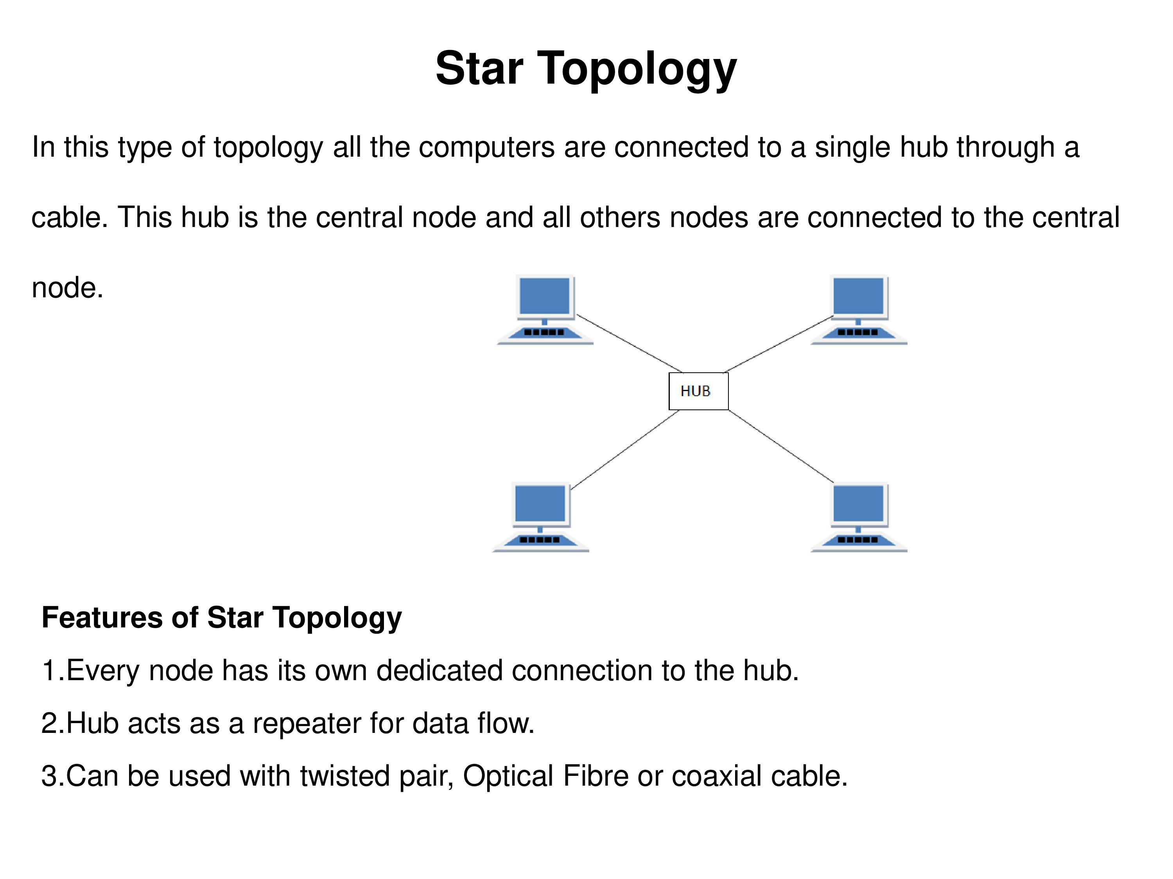
Star Topology

Slide 25
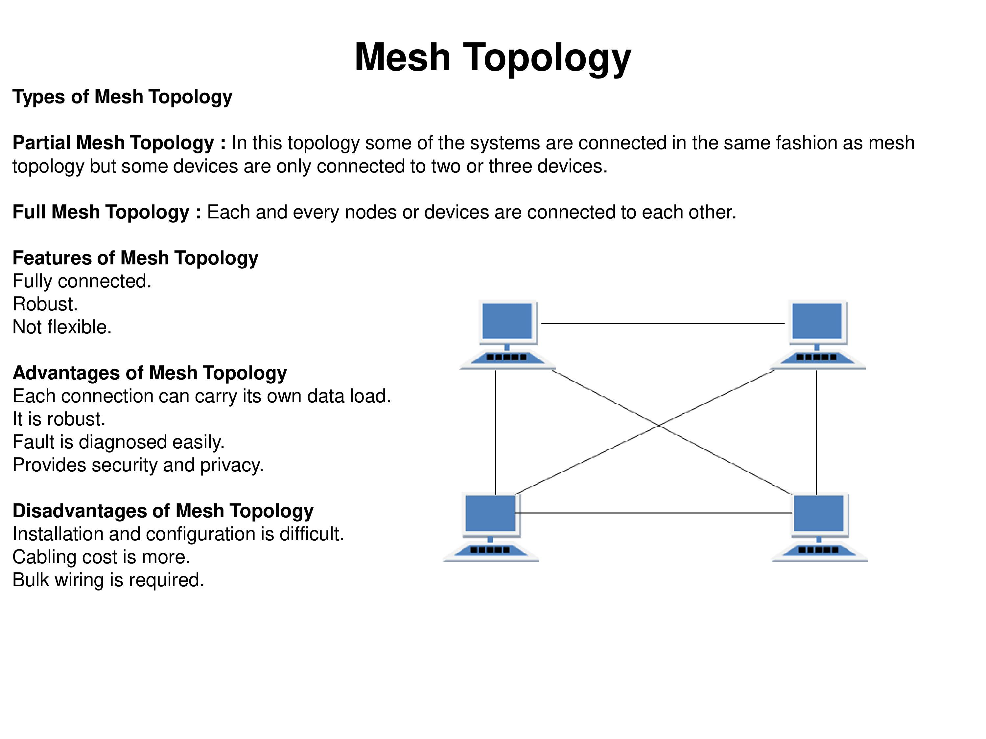
Mesh topology

Slide 26
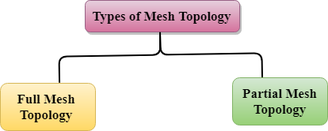
Types of Mesh Topology

Slide 27
Full Mesh Topology: In a full mesh topology, each computer is connected to all the computers available in the network.
Partial Mesh Topology: In a partial mesh topology, not all but certain computers are connected to those computers with which they communicate frequently.

Slide 28
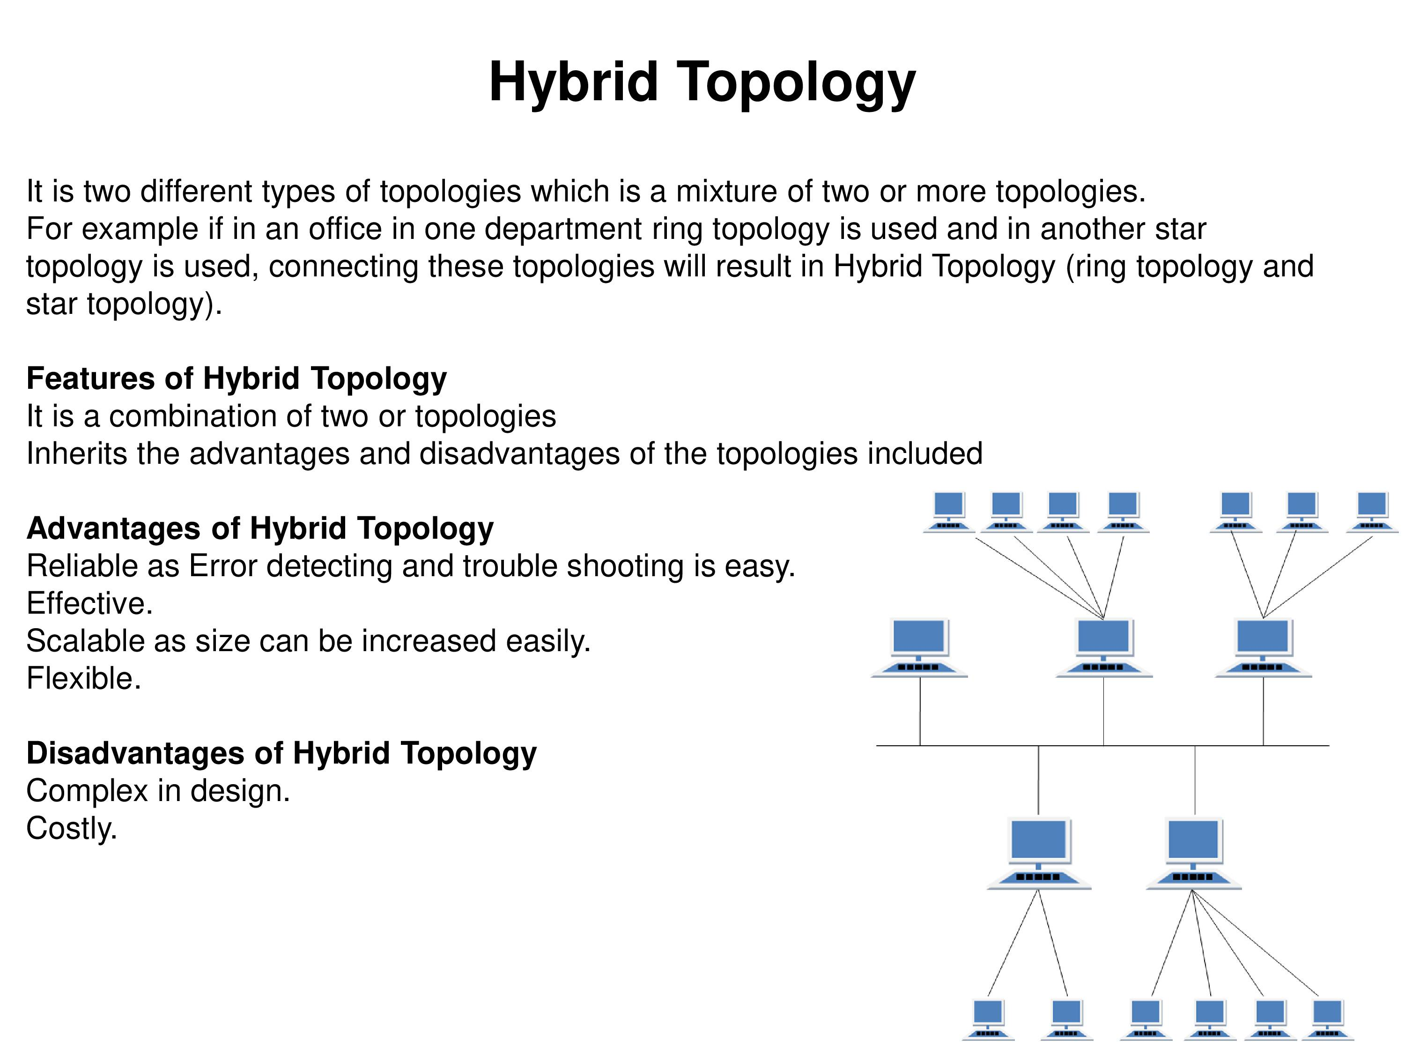
Hybrid Topology

